Slide 1
Evaluation IR systems

Slide 2
Measures for a search engine
Sec. 8.6
How fast does it index
  Number of documents/hour
  (Average document size)
How fast does it search
  Latency as a function of index size
Quality of results
  Precision
  Recall
  F-measure
Expressiveness of query language
  Ability to express complex information needs
Efficiency
Effectiveness
Usability

Slide 3
Evaluating an IR system
Sec. 8.1
Note: the information need is translated into a query
Relevance is assessed relative to the information need not the query
E.g., Information need: I'm looking for information on whether travelling by train from Cairo to Assuit is more effective than flying.
Query: travelling by train from Cairo to Assuit effective
Evaluate whether the doc addresses the information need, not whether it has these words

Slide 4
Standard relevance benchmarks
Sec. 8.2
TREC - National Institute of Standards and Technology (NIST) has run a large IR test bed for many years
Reuters and other benchmark doc collections used
“Retrieval tasks” specified
  sometimes as queries
Human experts mark, for each query and for each doc, Relevant or Nonrelevant
  or at least for subset of docs that some system returned for that query

Slide 5
Unranked retrieval evaluation:
Precision and Recall
Sec. 8.3
Precision: fraction of retrieved docs that are relevant = (relevant retrieved / retrieved)
Recall: fraction of relevant docs that are retrieved
= (relevant retrieved/relevant)
Precision P = tp/(tp + fp)
Recall R = tp/(tp + fn)
 | Relevant | Nonrelevant
Retrieved | tp | fp
Not Retrieved | fn | tn

Slide 6
Should we instead use the accuracy measure for evaluation?
Sec. 8.3
Given a query, an engine classifies each doc as “Relevant” or “Nonrelevant”
The accuracy of an engine: the fraction of these classifications that are correct
  (tp + tn) / ( tp + fp + fn + tn)
Accuracy is a commonly used evaluation measure in machine learning classification work

Slide 7
Precision/Recall
Sec. 8.3
You can get high recall (but low precision) by retrieving all docs for all queries!
Recall is a non-decreasing function of the number of docs retrieved
In a good system, precision decreases as either the number of docs retrieved or recall increases
  This is not a theorem, but a result with strong empirical confirmation

Slide 8
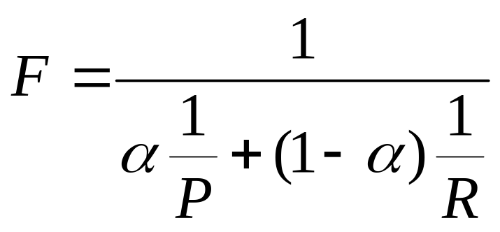
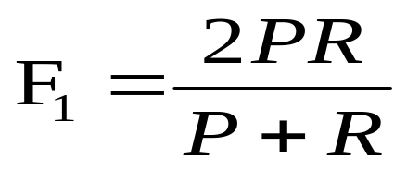
A combined measure: F
Sec. 8.3
Combined measure that assesses precision/recall tradeoff is F measure (weighted harmonic mean):
People usually use balanced F₁ measure
  i.e., with α = ½

Slide 9
Evaluating ranked results
Sec. 8.4
Evaluation of ranked results:
  The system can return any number of results
  By taking various numbers of the top returned documents (levels of recall), the evaluator can produce a precision-recall curve

Slide 10
Averaging over queries
Sec. 8.4
A precision-recall graph for one query isn’t a very sensible thing to look at
You need to average performance over a whole bunch of queries.
But there’s a technical issue:
  Precision-recall calculations place some points on the graph

Slide 11
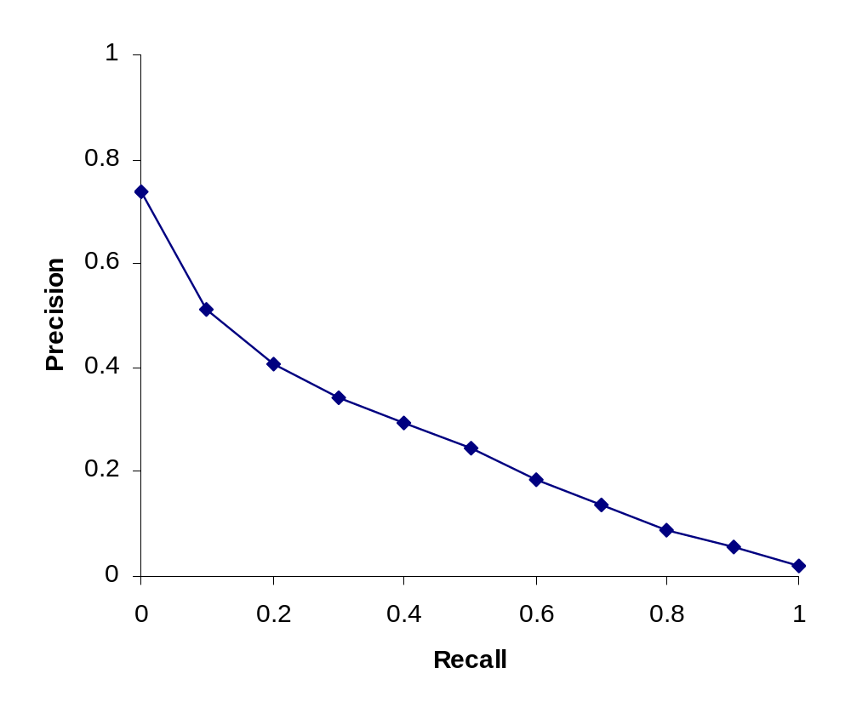
Typical (good) 11 point precisions
Sec. 8.4

